Slide 1
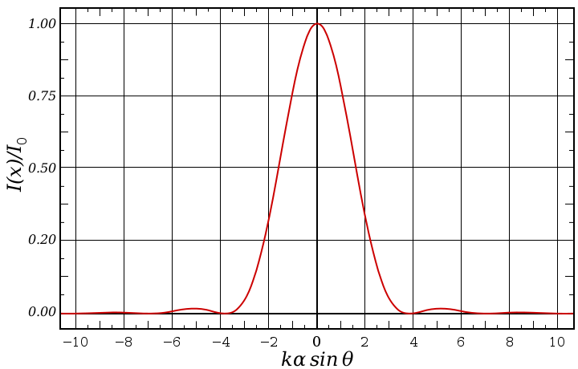
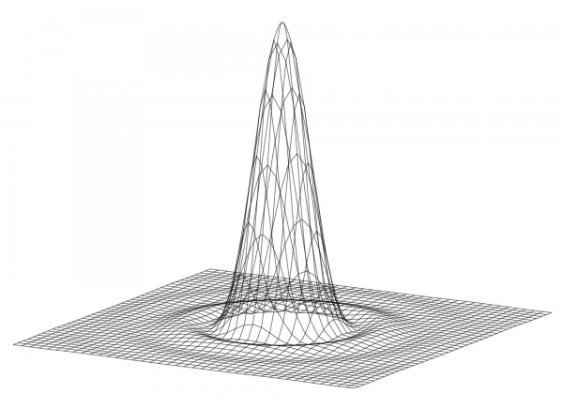
Lecture 5
Chemical Engineering for Micro/Nano Fabrication

Slide 2
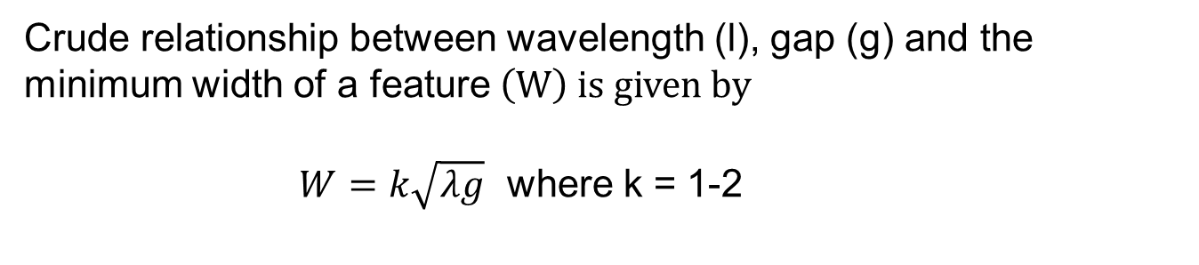
For a Rigorous modeling of Proximity Printing limits see:
Simulation of proximity printing
W. Henke, M. Weiss, R. Schwalm and J. Pelka Microelectronic Engineering 10 (1990) 127-152
Crude relationship between wavelength (l), gap (g) and the minimum width of a feature$\left(W\right) is given by$
$W=k\sqrt{λg}$ where k = 1-2

Slide 3
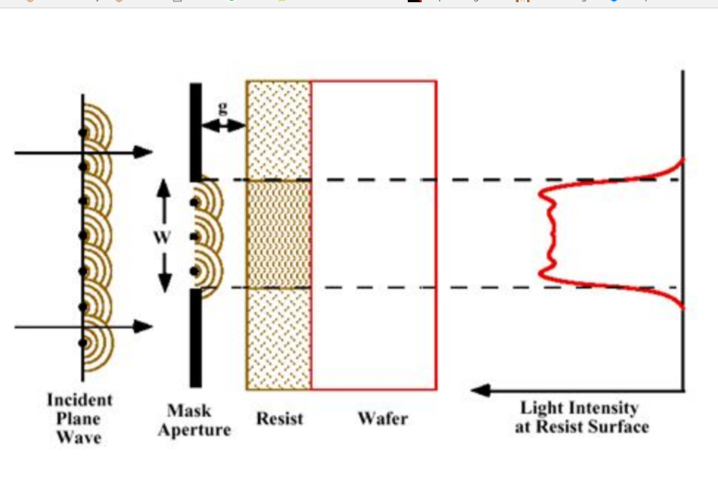
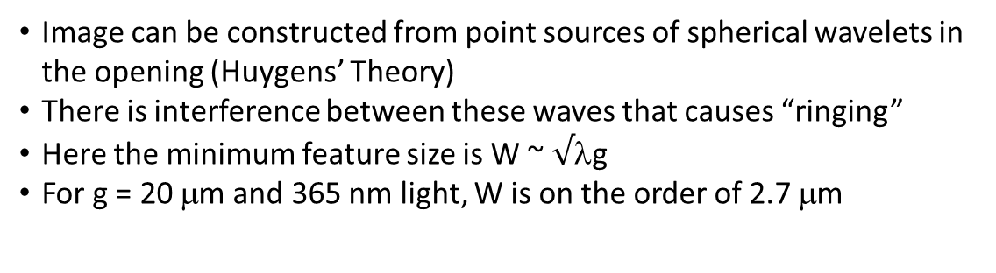
From Lecture 3
Fresnel Diffraction in Proximity Printing
Near field or Fresnel Diffraction Regime When g < W²/λ
Image can be constructed from point sources of spherical wavelets in the opening (Huygens’ Theory)
There is interference between these waves that causes “ringing”
Here the minimum feature size is W ~ $√$λg
For g = 20 μm and 365 nm light, W is on the order of 2.7 μm

Slide 4
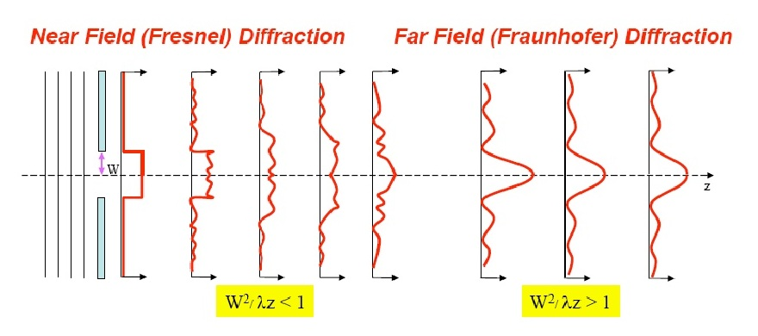
From Lecture 3
We also have have Frauenhofer Diffraction
Far Field Diffraction.
Please look carefully at these inequalities. Are they correct?

Slide 5
Resolution Limit of the Projection Printing
Theoretical Resolution
λ
θ_{max}
F= k₁
NA
F :
λ :
k₁ :
NA :
n :
Minimum feature size
Exposure wavelength
Process-dependent factor
Numerical aperture of lens system
Index of refraction (for air, n ≈ 1)
Aperture
Entrance
Pupil
NA = n sin θ_{max}
Feature size is directly related to the
wavelength of the exposure radiation

Slide 6
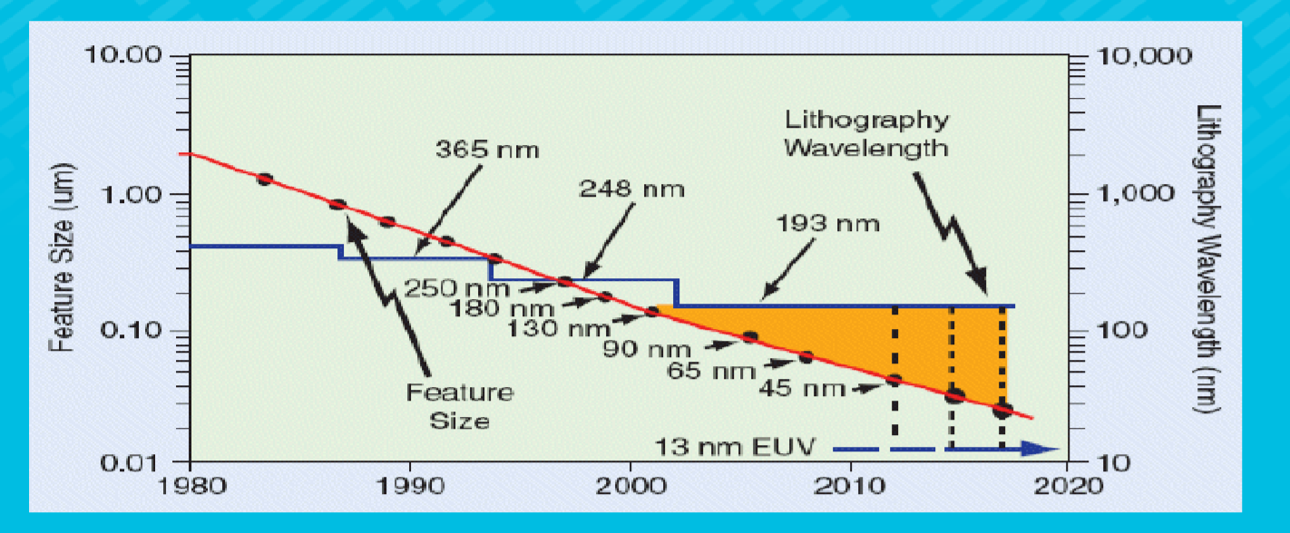
Wave Length Reduction History

Slide 7
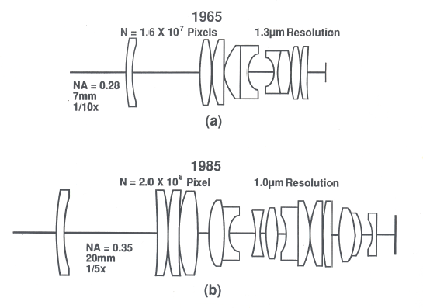
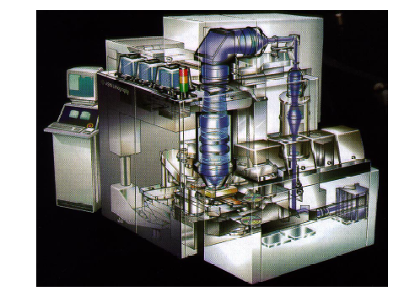
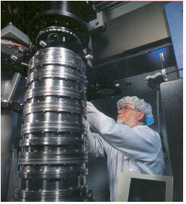
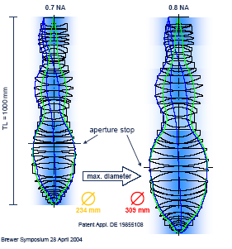
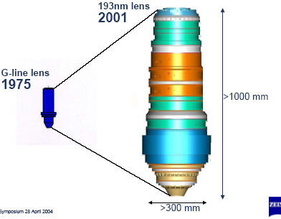
Lithographic Lens Evolution
Starlith 500 Lens (Zeiss)
Notes:
The PAS 5500/850 248nm DUV step and Scan
Starlith 500 Lens from Carl Zeiss – used in ASML PAS 5500/550B scanner for 180nm processes and a 26x33mm field.

Slide 8
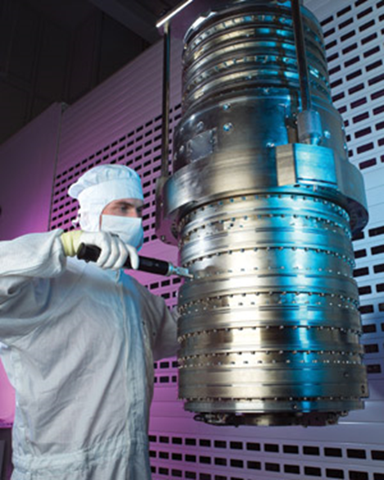
193 nm Immersion Lens
The stepper lens has a numerical aperture of NA = 1.35(huge!) and is intended for use in immersion lithography, a technique that replaces the air gap between wafer and stepper with water or another fluid. Zeiss notes that the device is, in some sense, the end of the art.
The lens is designed for an UV light source with a wave length of 193 nm, which needs an ArF (yes, "Argon Fluoride") Laser. Remember that the visible spectrum ends around 400 nm. UV radiation from the sun, for comparison, spans the range (315 - 400) nm ("Ultraviolet A") and (280 - 315) nm ("Ultraviolet B").
The producer of this lens is Carl Zeiss SMT AG , Germany.

Slide 9
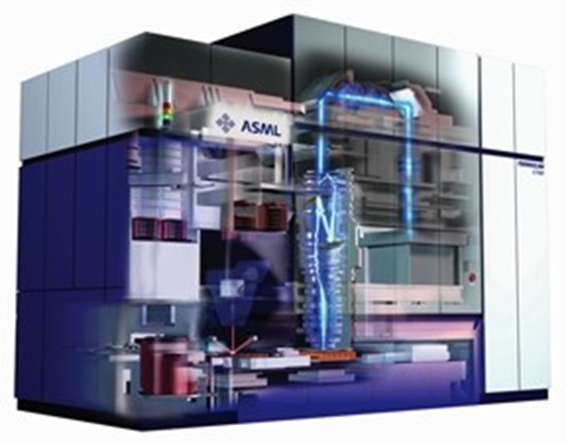
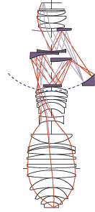
State of the art, 193 nm exposure tool
λ = 193nm
NA = 1.35
K = 0.3
Catadioptic Lens design

Slide 10
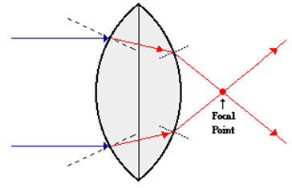
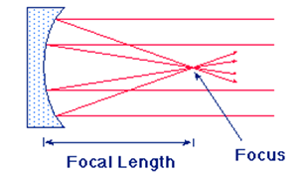
Focusing Light

Slide 11
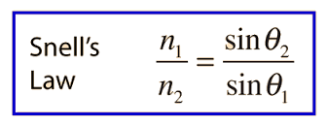
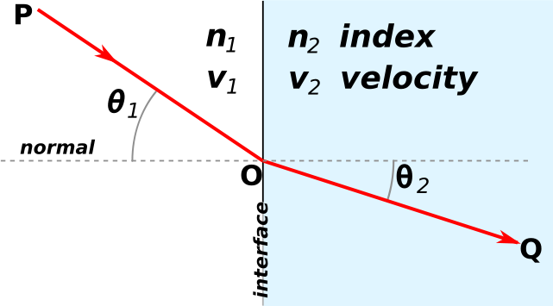
Snell’s Law

Slide 12
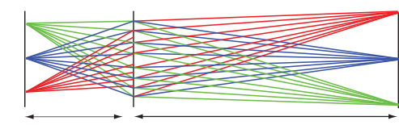

Off Axis Imaging
Imaging more than one spot or slit
https://www.youtube.com/watch?v=37H5jJmHh2Y

Slide 13
θ_{max}
+1
0
-1
Aperture
Entrance Pupil
NA = n sin θ_{max}

Slide 14
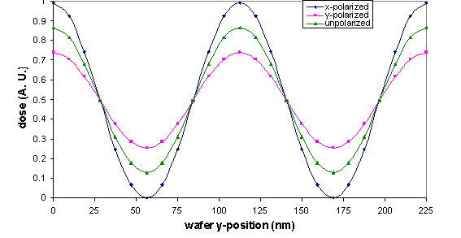
Aerial Image of a 56 nm grating

Slide 15
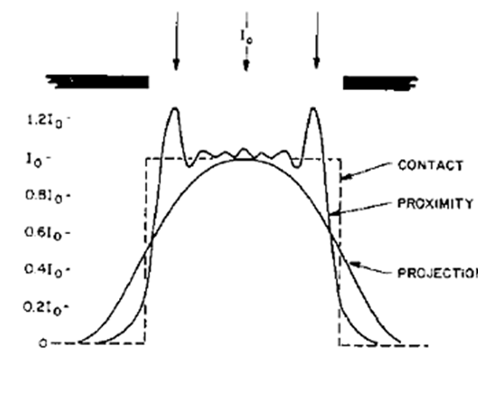
Aerial Image for the Aligner Designs

Slide 16
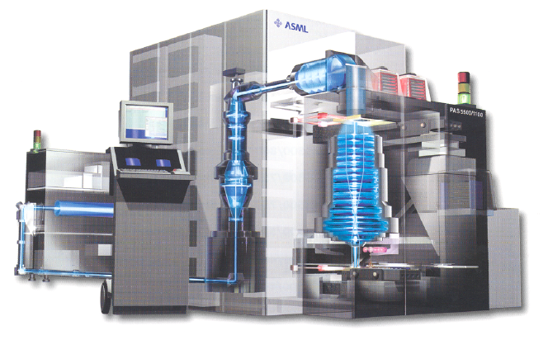
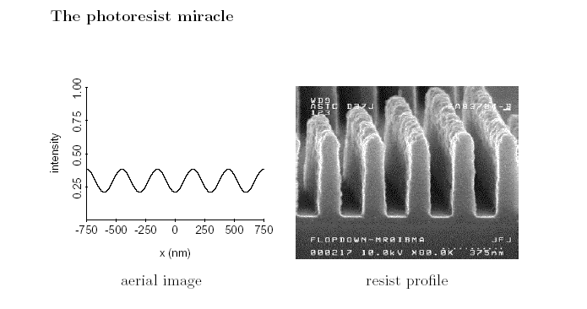
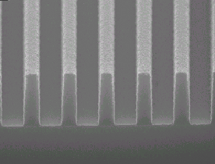
Chemist’s view of how things really work
Mask
aerial image
at the wafer
$$$$$$$$$$$$$
Amazing Chemistry!!
¢¢¢¢¢¢!!!
aerial image
aerial image
resist image

Slide 17
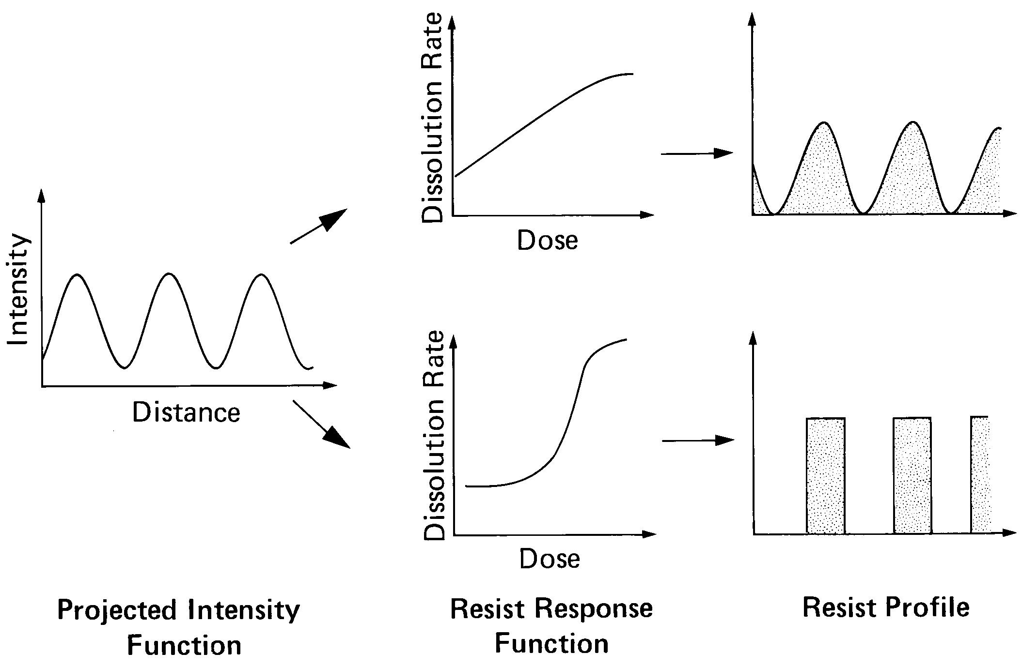
Non-linear dissolution rate response

Slide 18
Threshold like Response of ArF Resist
E₀

Slide 19
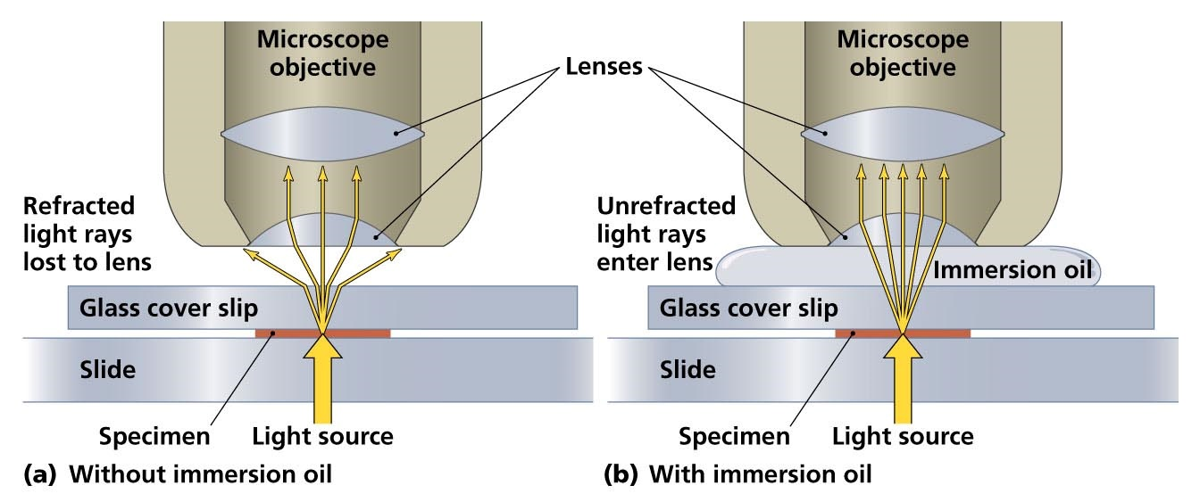
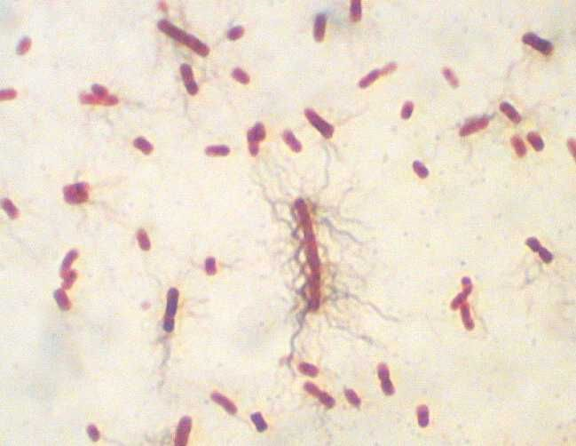
Oil Immersion Microscopy

Slide 20
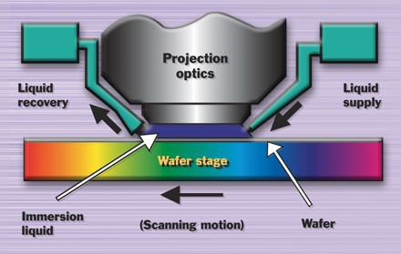
Liquid Immersion Lithography
Source: Nikon
Notes:
Only the final optical element and its housing, the wafer and stage are in contact with the immersion fluid.
High through-put Step and Scan Lithography where the wafer moves through exposure could be problematic because of fluid turbulence and index non-uniformities.
Small changes in temperature within the fluid would cause relatively large changes in focus position. Depending on dn/dT which would be difficult to control at high throughput.
Finally, imaging layer would have to be extremely thin.
All ducks are in a row for device manufacturing around 2007.
Technology is expected to work at both the 65nm and 45nm process nodes.
Availability of HyperNA lenses with NA >1.

Slide 21
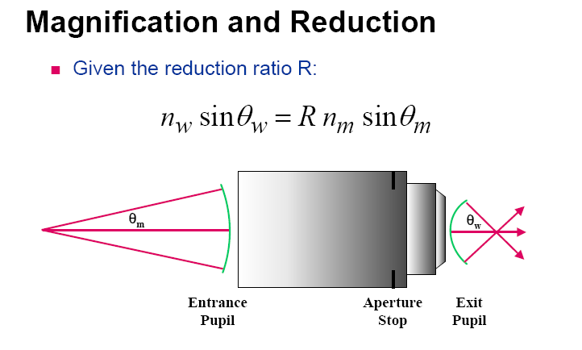


Immersion Microscopy
More orders are captured!!!
Fluid Here!

Slide 22
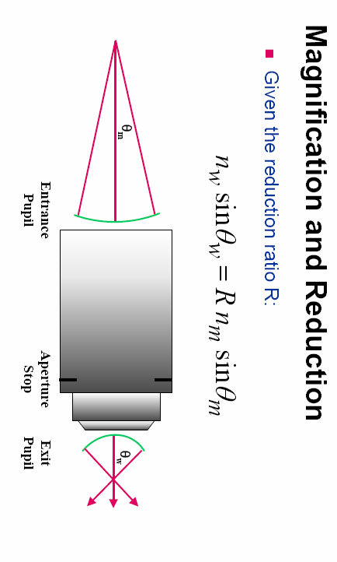
Immersion Lithography
Mask
No new rays are captured!!!
Fluid is here!?
Wafer

Slide 23
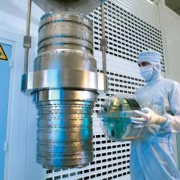
Chemist’s View of Immersion
Adding water to the space between the final lens and the wafer does not improve resolution.
It does improve depth of focus and therefore process latitude
It does allow design of high NA lenses that would otherwise not work!
Immersion Lens

Slide 24
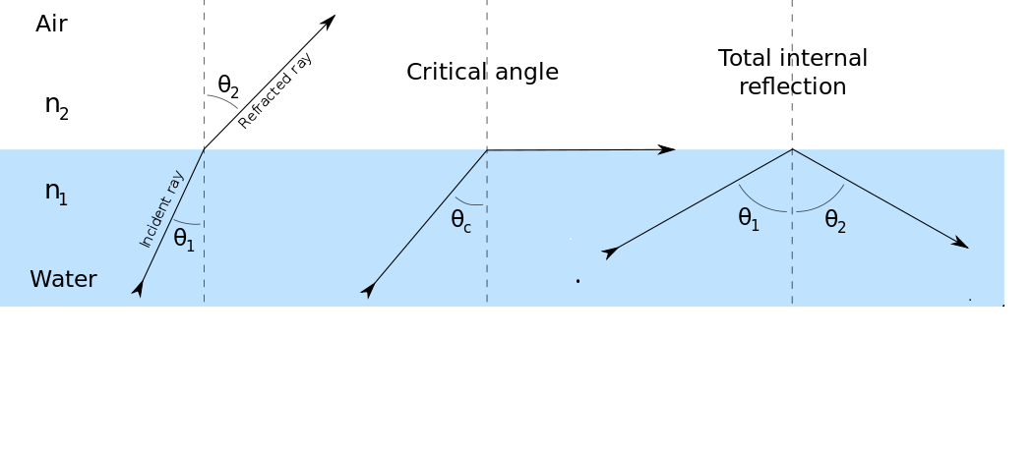
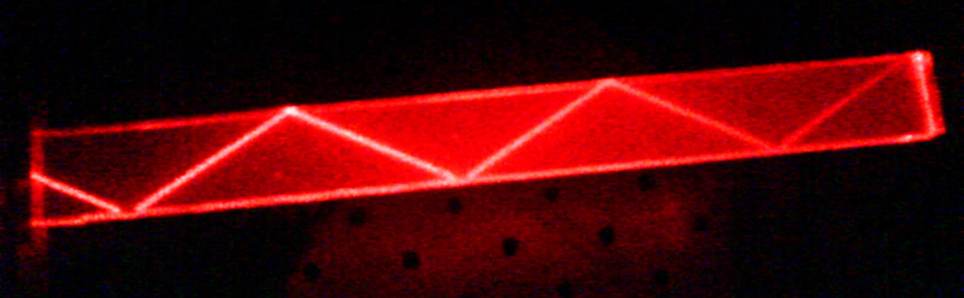
Critical angle & total internal reflection
https://en.wikipedia.org/wiki/Total_internal_reflection

Slide 25
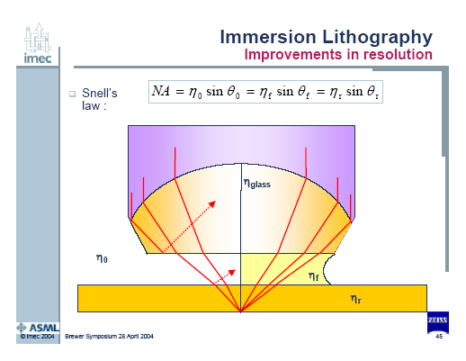
Notes:
Note: The addition of water to existing lenses does not increase the numerical aperture. Lenses of a given NA designed to operate in air can be modified to function as immersion lenses but their NA will typically be unchanged.

Slide 26

Lens diameter vs. NA
Lens diameter vs. NA
（4X, 26x33mm field)
$$$$$$$$$$$$$$$$
Liquid Immersion
Lens Diameter (A.U.)
All Spherical
With
Aspheres
0.6
0.7
0.8
0.9
1.0
1.1
1.2
NA
SPIE 2003 Feb.28 Santa Clara ML5048
-
68 Ohmura et. al.
Slide 1

Slide 27
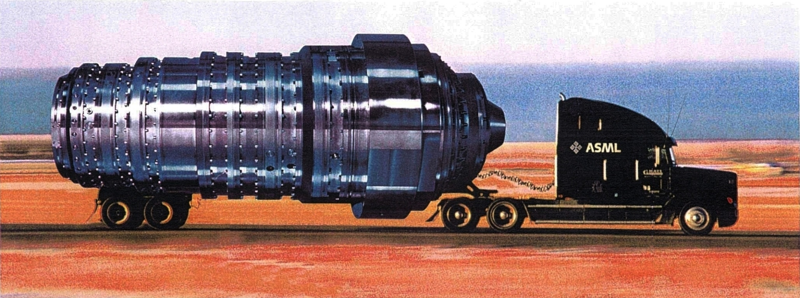
A Prophetic Advertisement??
Size Matters????

Slide 28
Optical Lithography Limits
n = 1 (Air)
n = 1.44 (Water)
k₁ = 0.3
λ = 193 nm
sinθ = 0.9
k₁ = 0.3
λ = 193 nm
sinθ = 0.9
R = 65
R = 45
≠ 22 !!

Slide 29
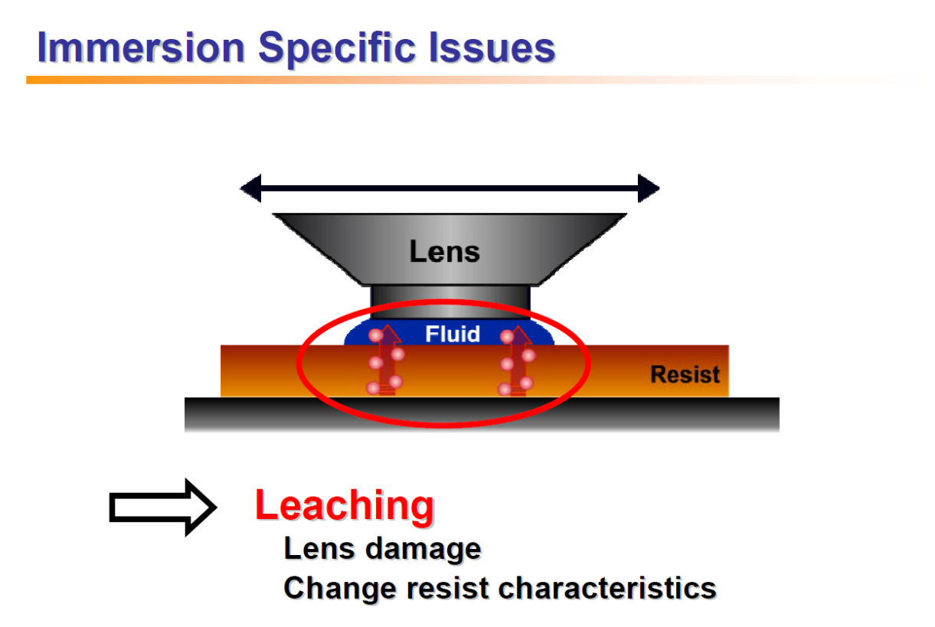

Slide 30
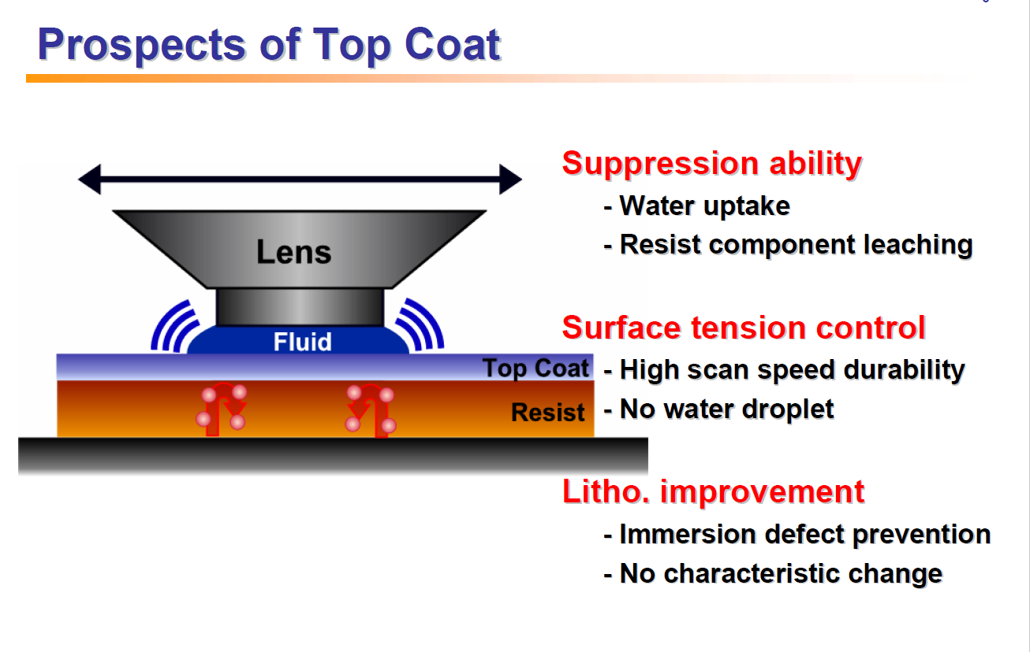

Slide 31
Limitations of water
Indices of refraction for water immersion.
  SiO₂: 1.56
  CaF₂: 1.51
  Water: 1.435
  Resists ~ 1.70
0.93*1.435 = 1.33
nsinθ ≤ 0.93* min(nglass, nfluid, nresist)
If k=0.25, R = 36nm

Slide 32
Options beyond water
Options for high index immersion lithography.
  Glass.
    BaLiF₃: 1.64
    (Lu₃Al₅O₁₂, LuAG): 2.1
    (Mg₃Al₂Si₃O₁₂,Pyrope): 2.0
  Fluid.
    Cyclic organics, such as decalin: 1.64-1.65

Slide 33
High Index Materials
2nd generation
3rd generation
Fluid
n = 1.64
Lens
LuAG (n = 2.1)
Fluid
n = 1.9*
Resist
n = 1.8
Decalin
R= 32nm
R= 37nm
No candidate has been identified for high index fluid or high index resist.

Slide 34
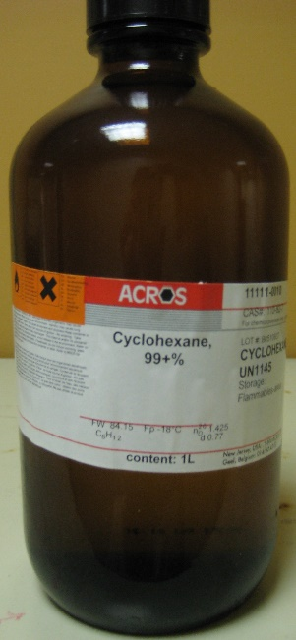
Cyclohexane
99+% Purity
1 – Sulfuric Acid Wash
2 – Sulfuric Acid Wash, Silica Gel Chromatography
3 – Sulfuric Acid Wash, Silica Gel Chromatography, Distillation
Absorbance (cm⁻¹)
4 – Sulfuric Acid Wash, Silica Gel Chromatography, Distillation, De-oxygenation
Wavelength (nm)

Slide 35
Absorbance Edge

Slide 36
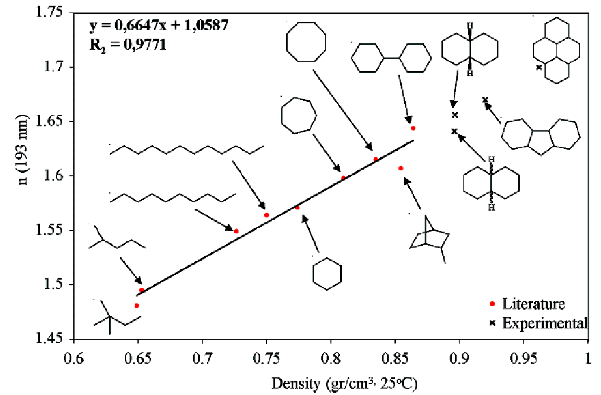
Cycloalkanes
x
Density 1.07 g/cm³
Highest RI is expected
n₁₉₃ = 1.73
Abs₁₉₃ = 0.13
López-Gejo et. al., Chem. Mater.19, 3641-3647 (2007)

Slide 37
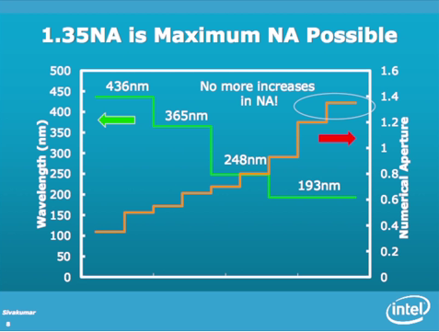

Slide 38
What variable is left to be optimized?
λ
R= k
NA
We have discussed λ
  I told you that 193nm is the lower limit
We have discussed NA
  I told you that 1.35 was the upper limit
The only thing left is…..
“k”

Slide 39
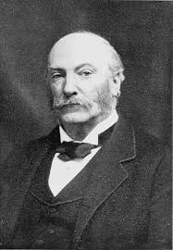
Rayleigh’s Rule…”k”
John William Strutt, third Baron Rayleigh
1842-1919
The Nobel Prize in Physics 1904

Slide 40
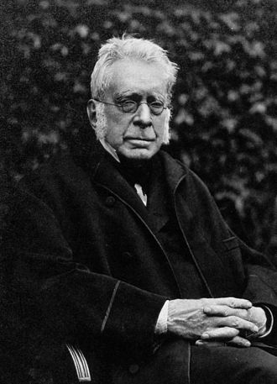
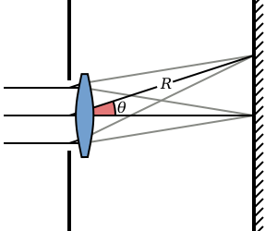
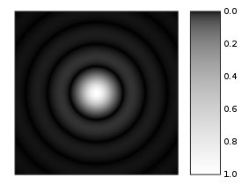
Sir George Airy
Airy disk is a description of the best focused spot of light that a perfect lens with a circular aperture can make
F

Slide 41
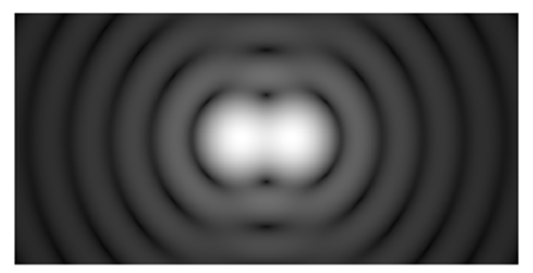
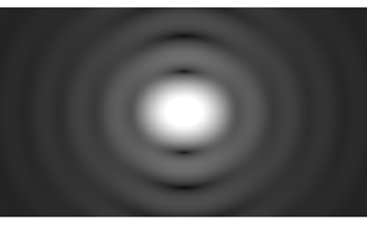
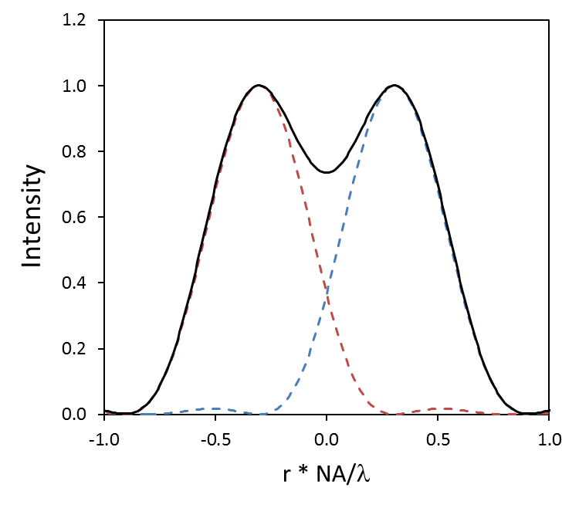
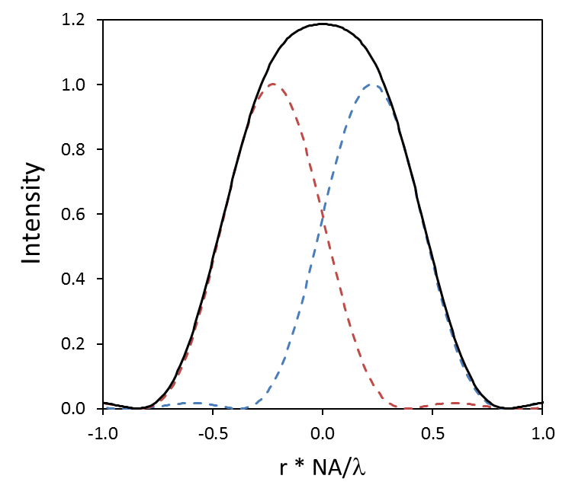


Rayleigh’s Rule for Resolution
Lord Rayleigh defined this criterion: when the first minimum of one Airy disk coincides with the maximum of another ->
$$0.6 λ/NA$$
$$0.6 λ/NA$$

Slide 42
Defining the resolution of an imaging system
When a single point of light is imaged it becomes the point spread function (PSF) of the lens system.
  For an ideal, circular imaging system, the PSF is called the Airy disk:
  The FWHM of the Airy disk is 0.5 λ/NA, which defines the smallest image of a point source

